Slide 1
Databases
Econ 524

Slide 2
What is a database?
A database is structured way of storing large amounts of data that is fast, secure, and reliable.
Databases are used everywhere:
  sales
  employees
  customer info
  course registration at Cal Poly
  student directory at Cal Poly
  etc.

Slide 3
What is a database?
A database consists of one or more tables.
Each table has a set of fields that define the kind of data stored in the table.
Each table has records which are the actual data – a record has entries for the various fields.
A table is like a data frame. The columns of the data frame are like fields and the rows are like records.
Two or more tables can be linked through the use of “keys” or ID’s that link records in one table to records in another table.

Slide 4
Example: Amazon
Amazon might have 1 table for its orders. This table has fields for orderID, customerID, itemID, price, tax, shippingcost,, shippingdate.
There might be another table for customers. This table has fields for customerID, name, email, address.
A user may want to lookup an order by orderID to see if it has shipped. That lookup only uses the orders table.
A user may want to lookup all orders places by a customer given their e-mail. That lookup uses both orders and customers table, which are linked by the customerID field.
Note that we intentionally don’t store all the customer data (name, email, address) in the orders table because there are many orders for each customer (many:1 relationship) and we don’t want to repeat the same data over and over again in the orders table.

Slide 5
Example: Amazon
Databases may be very large. There could be billions of orders for millions of customers.
It would be very very slow to store this kind of data in a spreadsheet and have to scan the whole file looking for an orderID or customerID for every new query.
Databases offer a fast way to do these kinds of lookups especially when using a pre-defined key like customerID or orderID to do the lookup.

Slide 6
Why in economics?
As noted above, it is common for companies to have their data stored in databases.
For economics analysis of data, you will need to run queries on the database to access the data you need for your analysis.
For example, your company might ask you to write a program that does some kind of forecast based on prior data. So, your program would query the database to get most recent data and then perform the statistical analysis. Then the forecast could be updated each month using the same queries to analyze the new data.

Slide 7
Database Design
Database design is beyond the scope of this class. It involves a lot of knowledge about how databases are optimized for fast lookups.
We will focus mostly on running queries to retrieve selected records from a database.
The language that is used to do this is called Structured Query Language (SQL)

Slide 8
SQL in Python
SQL is a standard language for querying a database that works for most databases (Oracle, MySQL, SQLite, etc.)
In Python, there are different modules that are used to interface with different kinds of databases. Although the syntax may differ slightly, the basic idea is that you first connect to the database and create a database connection object in Python. Then you create a cursor object, which is used to execute your SQL queries.
I will use SQLite for our database because it is simple and it is installed already with Anaconda/Python. It runs from a file rather than connecting to a server. I am using SQLite because it is the easiest way to teach the SQL language but the same queries can be used for other databases you may encounter.
If you have to connect with other databases, the main difference between the examples here will be how you connect to the database.
  If you have already written code to query a SQLite database, only small changes are needed to instead query a MySQL database.
  Your SQL queries will usually not need to be changed.
  You just have to import a new module for the new database, modify the connection code to go along with the syntax for the new module, and possibly add some initialization stuff like logging in.

Slide 9
Getting Ready to Use SQLite
import sqlite3
con = sqlite3.connect("chinook.db") #create connection object
....
con.close() #when you’re done!

Slide 10
Using SQLite with pandas
pd.read_sql_query provides an easy way to run SQL queries with the output going into a pandas dataframe.
This function utilizes functions from the sqlite3 module (or other SQL modules) to run queries.
I will focus on this pandas function which is easier to use since it wraps several function calls into a single function and since its output is easier to work with (dataframe vs list)

Slide 11
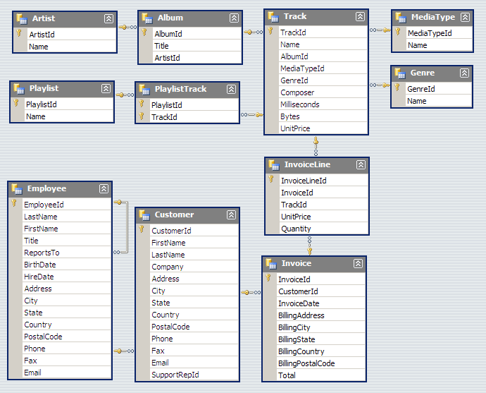
Sample Database: Chinook
Download chinook.db from Canvas.
Then try to connect:
import sqlite3
con = sqlite3.connect("chinook.db")

Slide 12
SQL
We will now cover some basic query syntax for the SQL language.
This is not in any way tied to Python. This is the SQL language and is the standard way to access any database.
For each SQL query that I show, to use in Python, we make the call
pd.read_sql_query(“…my SQL statement…”,con)
where con is the name of my connection object.
The Select statement in SQL is used to get some or all records from a table. This will be the primary focus of these slides.

Slide 13
SQL Select
SELECT is the command used to query a database.
select Name from Track
returns a column with all Names in Track table.
select Name, Milliseconds from Track
returns a data frame with 2 columns, Name and Milliseconds for all records in Track
select * from Track
returns the entire Track table (* mean all fields)

Slide 14
SQL Select … order by and limit
select * from Track order by Milliseconds
returns the entire track table ordered with shorter tracks first
select * from Track order by Milliseconds desc
returns the entire track table with longer tracks first
select * from Track order by Milliseconds limit 20
returns all fields in the Track table for the 20 shortest tracks

Slide 15
SQL select … where
Typically you want to select a subset of the entire table based on one or more fields. “where” helps us with this.
select * from Track where Name=‘Yesterday’
returns all fields in the Track table for records with the Name field equal to Yesterday.
select AlbumID, Milliseconds from Track where Name=‘Yesterday’
returns album and length of all tracks named Yesterday
select Name from Track where Milliseconds<120000
returns the names of all tracks less than 2 minutes long

Slide 16
SQL select … where
Logical operators “and” and “or” allow for checking multiple conditions with where.
select * from Track where Milliseconds<120000 and UnitPrice>0.99
returns all fields in the Track table for tracks that are less than 2 minutes in length and cost at least $1.
select * from Track where Milliseconds<120000 or UnitPrice>0.99
returns all fields in the Track table for tracks less than 2 minutes in length and all fields for tracks that are at least $1 in price.

Slide 17
(Aside: sqlite3 in python)
This query finds all tracks named “Resolve”:
df = pd.read_sql_query("select * from Track where Name='Resolve'",con)
Sometimes you want to run a similar query but where the name to lookup is determined dynamically in your program, so you don’t know the name at the time you’re writing your query.
With sqlite3, you can supply a ? in your query for every instance of something you want to define dynamically. Then supply a list of values (one for each ?) as the params argument to read_sql_query:
trackname="Resolve"
df = pd.read_sql_query("select * from Track where Name=?;",con,params=[trackname])
Note: some databases in python use a different syntax instead of ? so it’s important to read docs for your database to do this correctly.

Slide 18
Calculations with select
select max(Milliseconds) from Track;
select avg(Milliseconds) from Track;
select avg(Milliseconds)/60000 from Track;
select max(Milliseconds)/60000 from Track;
select sum(Bytes) from Track;
select count(Name) from Track where Milliseconds<120000;
returns number of tracks less than 2 minutes long

Slide 19
group by
select CustomerId, sum(Total) from Invoice group by CustomerId;
group by means to calculate a separate sum of Total for every CustomerID.
Instead of the result having just one entry with the overall sum of Total, it will have one entry for every customer with the sum of that customer’s Total.
select State, count(CustomerId) from Customer where Country='USA' group by State;
returns the number of customers in every state in the U.S.

Slide 20
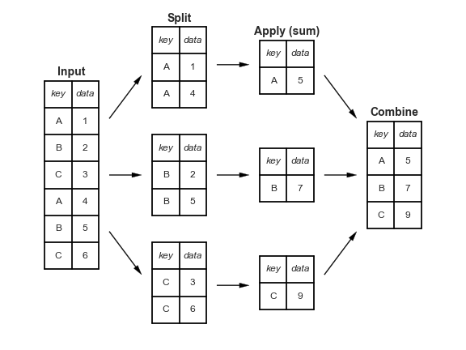

Slide 21
having
What if we want the CustomerID of all customers who spent over $40?
select CustomerId, sum(Total) from Invoice group by CustomerId;
yields the total spent by each customer.
Problem: I can’t use where to select only those over $40 because sum(Total) is not field that can be used in where clauses.
having solves this problem.
select CustomerId, sum(Total) as InvoiceTotal from Invoice group by CustomerId having InvoiceTotal > 40;
The “as” is a way to name the result so that we can use it in having.

Slide 22
distinct
distinct specifies to keep unique values, not to have duplicate rows with the same value.
Compare:
select AlbumID from Track;
and:
select distinct AlbumID from Track;
Because there are multiple tracks per album, the first query will have one row for every track so each AlbumId will appear multiple times.
The second query will have each AlbumID only once.

Slide 23
Practice Problems
1. Find the TrackId, UnitPrice and Quantity for all tracks sold for more than $0.99.
2. Find the ArtistId for Pink Floyd.
3. Find the AlbumId and the total length in minutes for all albums.
4. Find the AlbumId and the total length in minutes for all albums that are 60 minutes or longer. Provide results in descending order.
Call your script: sql_inclass.py
Save your dataframes as d1, d2, d3, d4

Slide 24
Multiple Table Queries
Most SQL queries involve data from 2 or more tables.
Basic Idea: Use keys to link tables.
These are called “joins” and are similar to the merge function in pandas.

Slide 25
Subject | Gender | Age
1 | 0 | 20
2 | 1 | 19
select * from choices join demo using (Subject)
Subject | Round | Choice
1 | 1 | 4
1 | 2 | 3
2 | 1 | 2
2 | 2 | 4
Subject | Round | Choice | Gender | Age
1 | 1 | 4 | 0 | 20
1 | 2 | 3 | 0 | 20
2 | 1 | 2 | 1 | 19
2 | 2 | 4 | 1 | 19

Slide 26
Joins
Get a list of all album names and the artist name that made the album.
This means combining the info in the Artist table with the Album table.
The ArtistId field is the link between the 2 tables.
select Name, Title from Album join Artist using (ArtistId)
The join word in SQL means to join Album and Artist tables.
The using word in SQL is followed by the field to use for the join. i.e. the query finds records in the two tables that have matching ArtistId’s and create a record for each match.

Slide 27
Joins
What if the fields linking the two tables had different names?
For example, suppose the Artist table had two fields: Id and Name (instead of ArtistId and Name) but the Album field was unchanged.
select Name, Title from Album join Artist on Album.ArtistId=Artist.Id
This finds all matches between ArtistId field in Album table and Id field in Artist table and selects the Name (from Artist) and Title (from Album).
Note that in this and the previous query, I didn’t have to specify a table for Name (in Artist table) or Title (in Album table) because those fields only appear in one table so there is no ambiguity.

Slide 28
Natural Join
In our example, there is an even easier way to join.
If there is only one field name in common, we can use natural join instead of join. This automatically links using the common field name.
select Name, Title from Album natural join Artist

Slide 29
Inner Join
By default, join means an inner join. You can also use “inner join” instead of “join” in our first 2 examples. This distinguishes from other types of joins.
select Name, Title from Album inner join Artist using (ArtistId)
select Name, Title from Album inner join Artist on Album.ArtistId=Artist.Id
To do outer join, use “full join”.
Also available: “left join” and “right join”

Slide 30
Practice Problem
Write a query to find the CustomerID, TrackId, Quantity, and UnitPrice for all track purchases.
Call your script: sql_inclass.py
Save your dataframe as d5

Slide 31
Joins
Now suppose we want to get a list of track names along with the corresponding album and artist names.
This involves 3 tables and also has a problem that both Artist and Track have fields named “Name”.
select Artist.Name, Title, Track.Name from Album join Artist using (ArtistId) join Track using (AlbumId)
This links Album to Artist using ArtistId and Album to Track using AlbumId.
To deal with the ambiguity of Name, we identify the table using the syntax TableName.FieldName.
This syntax (TableName.FieldName) is always optional but only required when there is ambiguity.

Slide 32
Joins
In the previous query, the result in Python would still have ambiguity about the name.
We may want to “name” our fields.
select Artist.Name as ArtistName, Title as AlbumTitle, Track.Name as TrackName from Album join Artist using (ArtistId) join Track using (AlbumId)

Slide 33
Joins
There are other ways to join 3 or more tables.
select Artist.Name, Title, Track.Name from Track join (Album join Artist using (ArtistId)) using (AlbumId)
This links Album to Artist using ArtistId and joins that “joined table” to Track using “AlbumId”
Same Results

Slide 34
Practice Problem
Write a query to find the customer last name, first name, the track name, quantity, the unit price for all track purchases.
Call your script: sql_inclass.py
Save your dataframe as d6

Slide 35
Joins
So far, our joins have not used where.
Let’s find the track names on the album “Supernatural”
The album name is not part of the Track table, but the AlbumId field is.
We will use the AlbumId field to link the Album and Track tables.
select Name from Track join Album using (AlbumId) where Title='Supernatural’

Slide 36
Joins
Can still use “order by” to order results as well as other options from last time like group by and limit, etc.
select Artist.Name as ArtistName, Title as AlbumTitle, Track.Name as TrackName from Album join Artist using (ArtistId) join Track using (AlbumId) order by ArtistName, AlbumTitle
sorted first by Artist, then Album
select Artist.Name as ArtistName, Title as AlbumTitle, sum(Milliseconds)/1000 as Length from Album join Artist using (ArtistId) join Track using (AlbumId) group by AlbumId order by ArtistName, AlbumTitle
one entry per album with album name, artist name, and length in seconds
select Artist.Name as ArtistName, Title as AlbumTitle, sum(Milliseconds)/1000 as Length from Album join Artist using (ArtistId) join Track using (AlbumId) group by AlbumId having Length>1000 order by Length desc
same as previous but only albums more than 1000 seconds long and sorted by Length instead of Artist

Slide 37
Joins
You can also specify “names” for your tables as follows. Note that this is optional here but will be required in some queries later.
select A.Name as ArtistName, Title as AlbumTitle, T.Name as TrackName from Album join Artist as A using (ArtistId) join Track as T using (AlbumId) order by ArtistName, AlbumTitle

Slide 38
Practice Problem
Write a query to find the CustomerID, TrackId, Quantity, and UnitPrice for all track purchases on invoices that totaled more than $20. Place results in descending order of the invoice total.
Call your script: sql_inclass.py
Save your dataframe as d7

Slide 39
Joins
Sometimes we need to join a table more than once – then naming becomes important.
Example: Find the names of all albums that have a track less than a minute in length and one greater then 5 minutes.
Attempt 1:
select Title from Album join Track using (AlbumId) where Milliseconds<60000 and Milliseconds>360000
Problem: Milliseconds can’t be greater than 360000 and less than 60000, no records returned
Attempt 2:
select distinct Title from Album join Track as T1 using (AlbumId) join Track as T2 using (AlbumId) where T1.Milliseconds<60000 and T2.Milliseconds>360000
Why did I add distinct?

Slide 40
Joins
You can join a table to itself, too
Example: Find the AlbumId of all albums that have a track less than a minute in length and one greater then 5 minutes.
select distinct AlbumId from Track as T1 join Track as T2 using (AlbumId) where T1.Milliseconds<60000 and T2.Milliseconds>360000

Slide 41
Joins
Another Example: Find the AlbumId of all albums that have a track less than a minute in length OR one greater then 5 minutes.
select distinct AlbumId from Track where Milliseconds<60000 or Milliseconds>360000
No need for join with OR but there was with AND

Slide 42
Practice Problem
Find all customer information for all customers who had 2 or more orders for over $10.
Call your script: sql_inclass.py
Save your dataframe as d8

Slide 43
Nested Queries
You can select data from the results of another query by placing the inner query in parentheses.
For example, suppose we want to find the customer that ordered the fewest unique tracks.
First we need to find how many tracks each customer ordered, since that is not already in the database anywhere. Then we can select the customer who had the fewest.
select customerid, count(TrackId) as numtracks from Customer join Invoice using (CustomerId) join InvoiceLine using (InvoiceId) group by CustomerId;
The query above creates a table with customerId and number of tracks ordered.
select customerid, min(numtracks) from (select customerid, count(TrackId) as numtracks from Customer join Invoice using (CustomerId) join InvoiceLine using (InvoiceId) group by CustomerId);
The query above finds the customerId and num tracks of the customer who ordered the fewest tracks. Note that the text in blue (and in parentheses) is identical to the first query.

Slide 44
Adding data to database
create table is a another kind of SQL statement
create table Team (id integer, name text)
creates table named Team with 2 fields, id and name.
How to call with sqlite3 module:
crsr = con.cursor()
crsr.execute(“create table Team (id integer, name text)”)
con.commit() #not needed after every execute statement but should be called once when modifications are complete

Slide 45
Adding data to database
create table is a another kind of SQL statement
create table Team (id integer, name text, primary key (id))
creates table named Team with 2 fields, id and name.
id is set to be the primary key.
primary key cannot occur twice in table – could use TrackId for Track but not AlbumId
setting a primary key improves performance of lookup using the key.

Slide 46
Adding data to database
insert into is SQL command for adding records:
insert into Team values (1, ‘Florida’)
How to call with sqlite3:
crsr.execute(“insert into Team values (1, ‘Florida’)”)

Slide 47
Adding data to database
can use data from other tables with insert into:
insert into Team select CustomerId, LastName from Customer where State=‘California’
inserts one record into Team for each customer from California where CustomerId becomes id and LastName becomes Name

Slide 48
Alternative in pandas: to_sql
If df is a pandas dataframe:
df.to_sql(“Table Name”, con,if_exists=“replace”)
creates table named “Table Name” in the database (replacing it if already exists) and fills in with data from df.

Slide 49
Removing data to database
delete from Team where id<100
deletes all records with id<100
drop table Team
removes the table Team
Use crsr.execute(...) for both of these.

